Slide 1
FLIGHT MANAGEMENT SYSTEM
Le Phuong Trung – B2005900
Ngu Cong Khanh – B2012022
Nguyen Hoang Dang Huy – B2014915

Slide 2
FUNCTIONS

Slide 3
Functions
Login as employee
Login as passenger
Create ticket transaction
Rollback ticket transaction

Slide 4
Functions
Add information of planes
Update information of planes
Show information of planes

Slide 5
Functions
Add information of flight
Update information of flight
Show information of flight

Slide 6
Functions
Add information of employee
Update information of employee
Show information of employee

Slide 7
Functions
Add information of passenger
Update information of passenger
Show information of passenger

Slide 8
Functions
Delete plane by plane ID
Delete flight by flight ID
Delete employee by employee ID
Delete passenger by passenger ID
Delete ticket by ticket ID

Slide 9
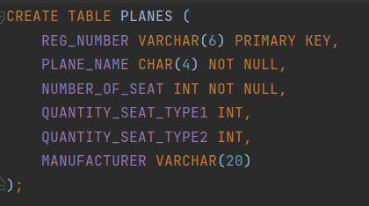
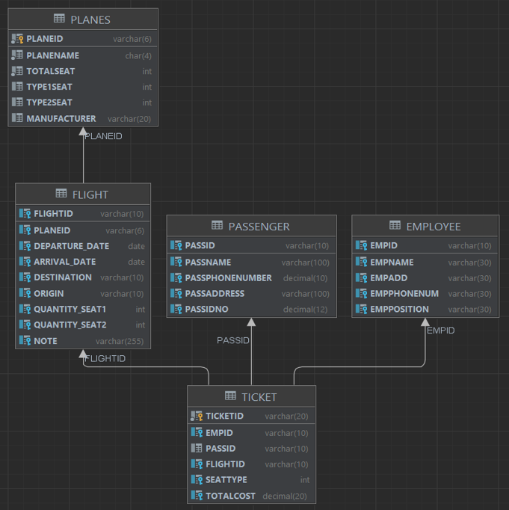
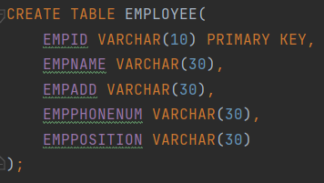
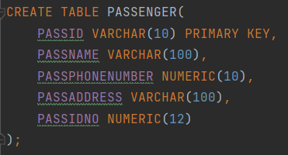
DATABASE

Slide 10
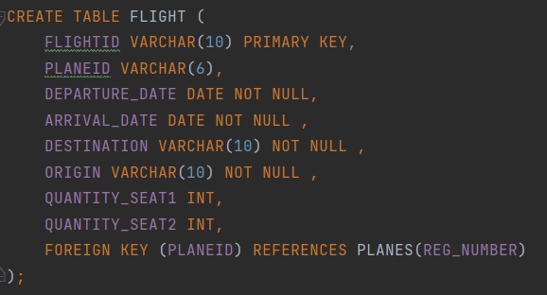
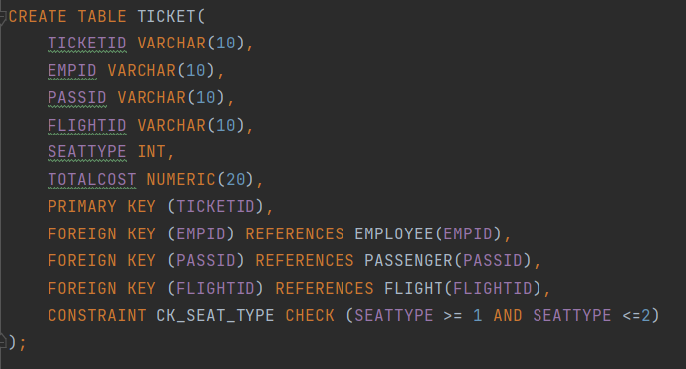
DATABASE

Slide 11
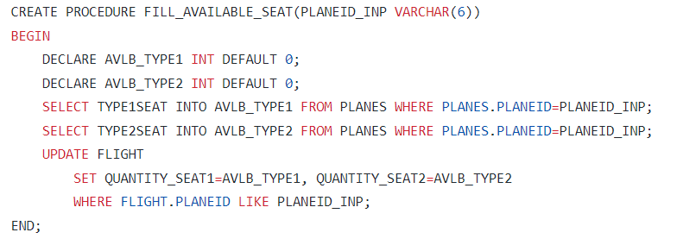
PROCEDURE
Procedure to initiate the number of available seat for newly added flights

Slide 12
USER INTERFACES

Slide 13
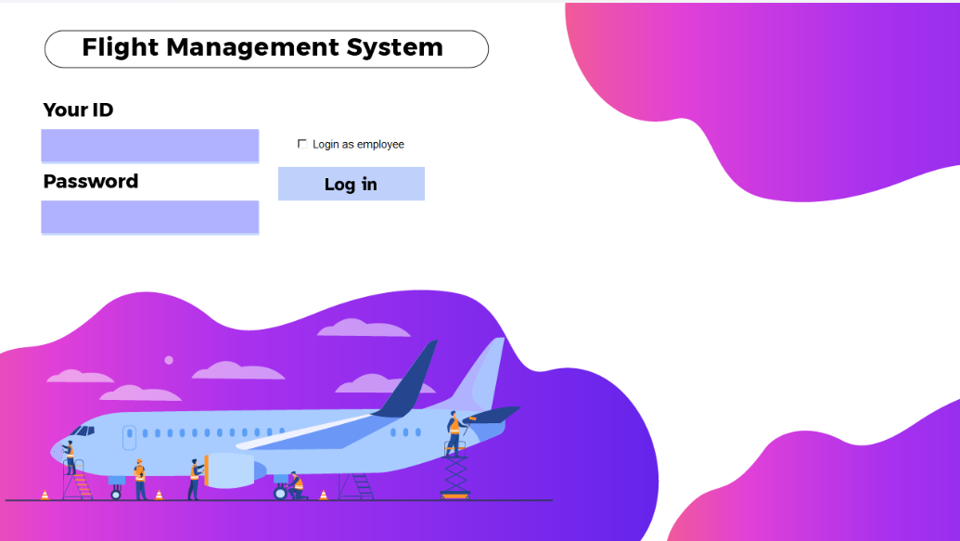
Login screen

Slide 14
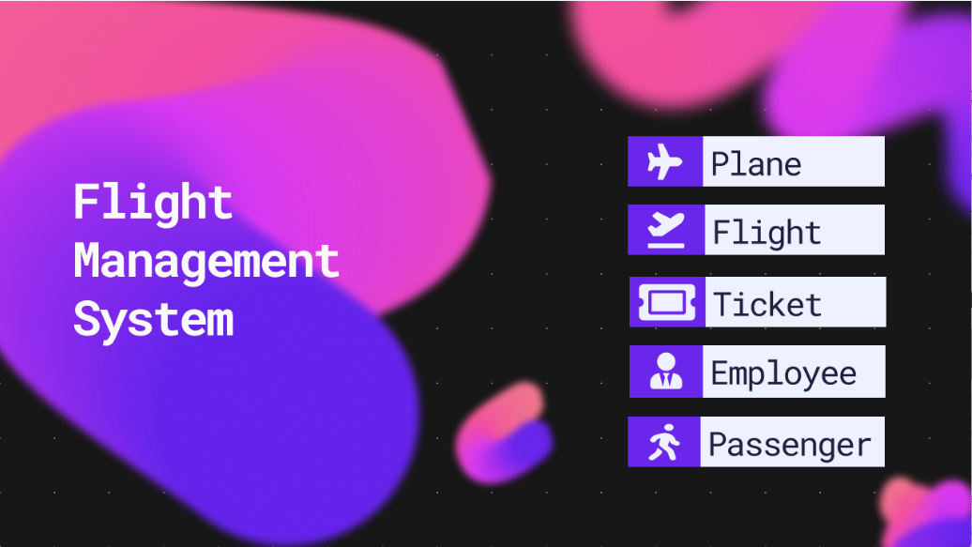
Employee dashboard and related screens

Slide 15
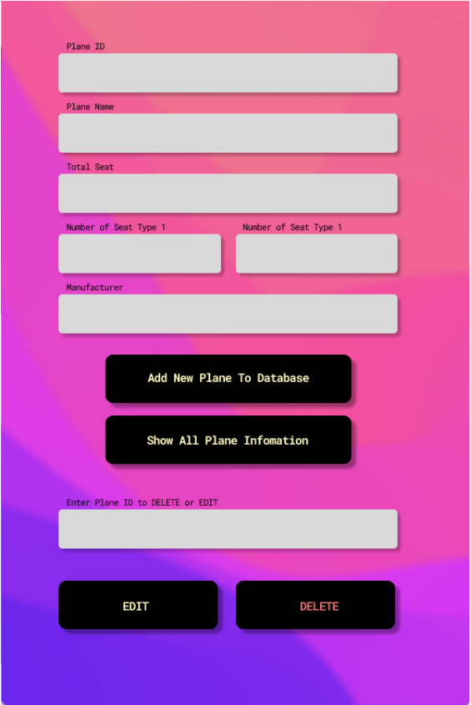
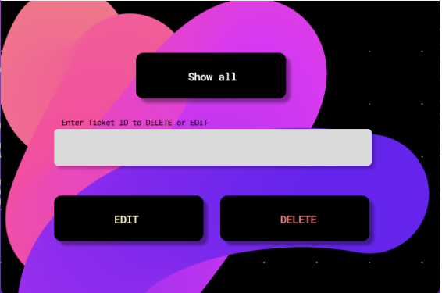
Employee planes management and tickets manament

Slide 16
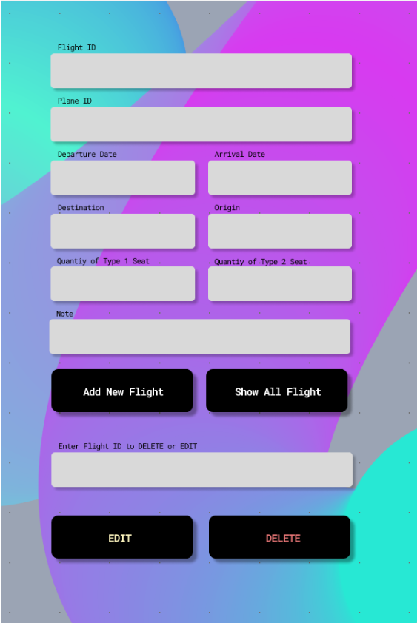
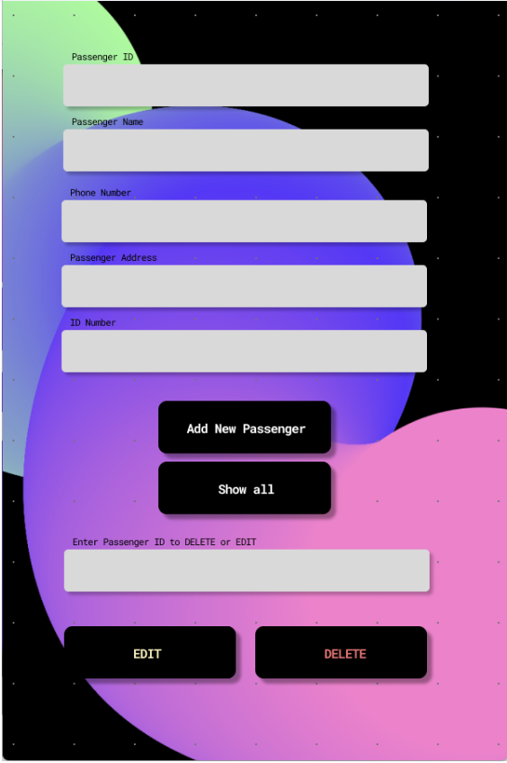
Employee flights management and Employee passengers management

Slide 17
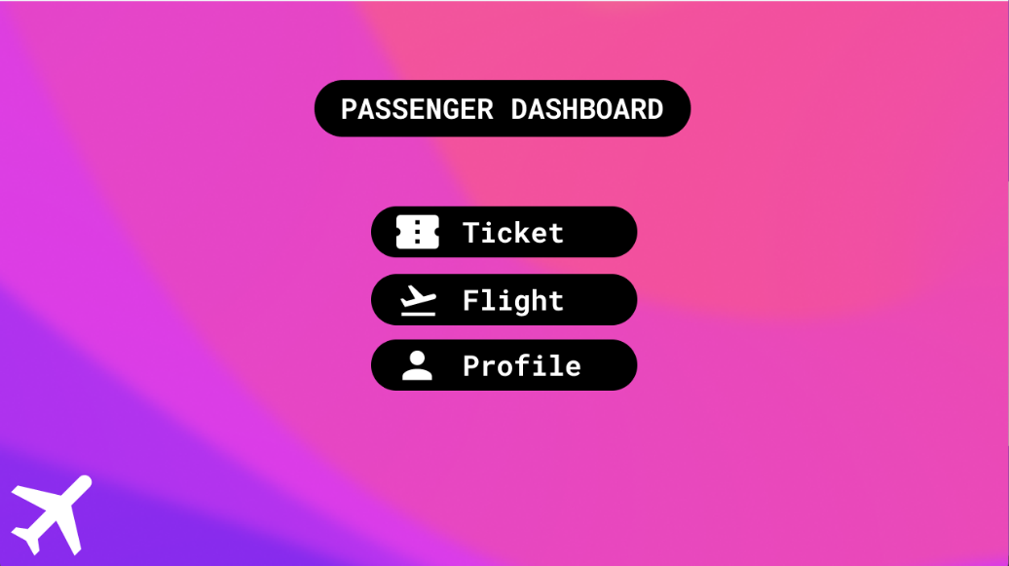
Passenger dashboard and related screens

Slide 18
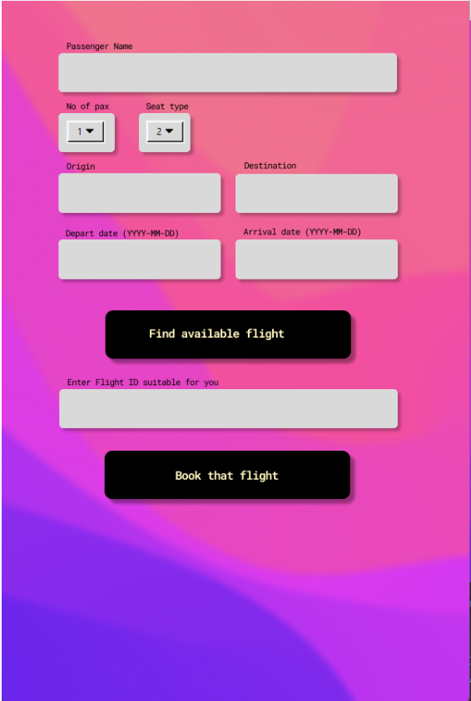
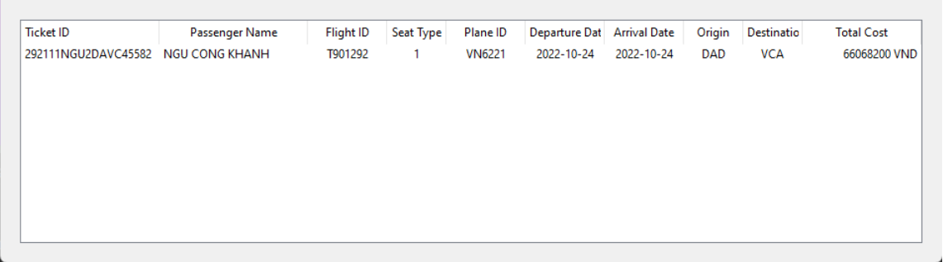
Passenger booking and flights information

Slide 19
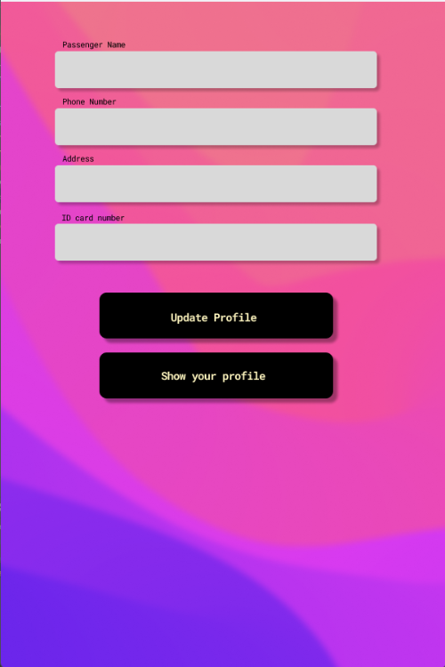
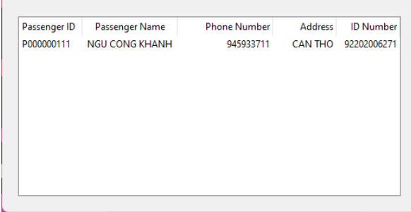
Passenger update information and flights information

Slide 20
Thanks for listening!

